Slide 1

    Topics and Trends:
    Directors and Officers Liability
    NORIMA 14/09/2023

Slide 2
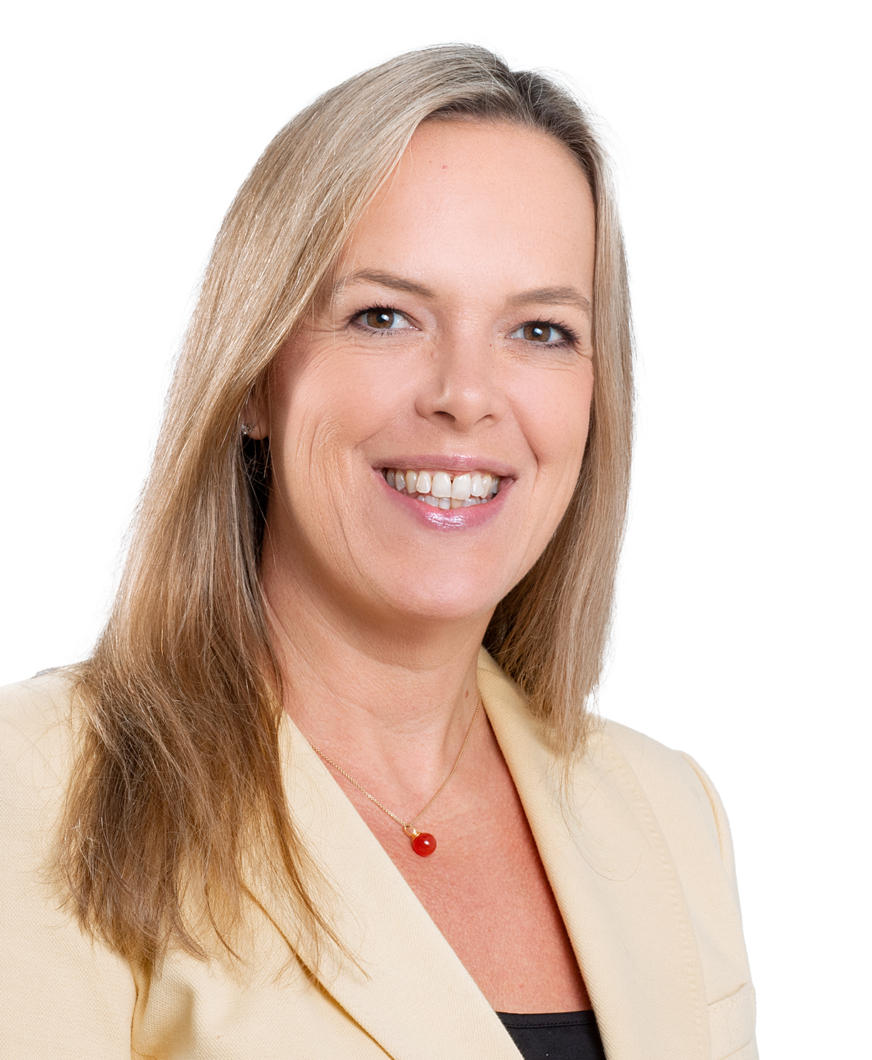
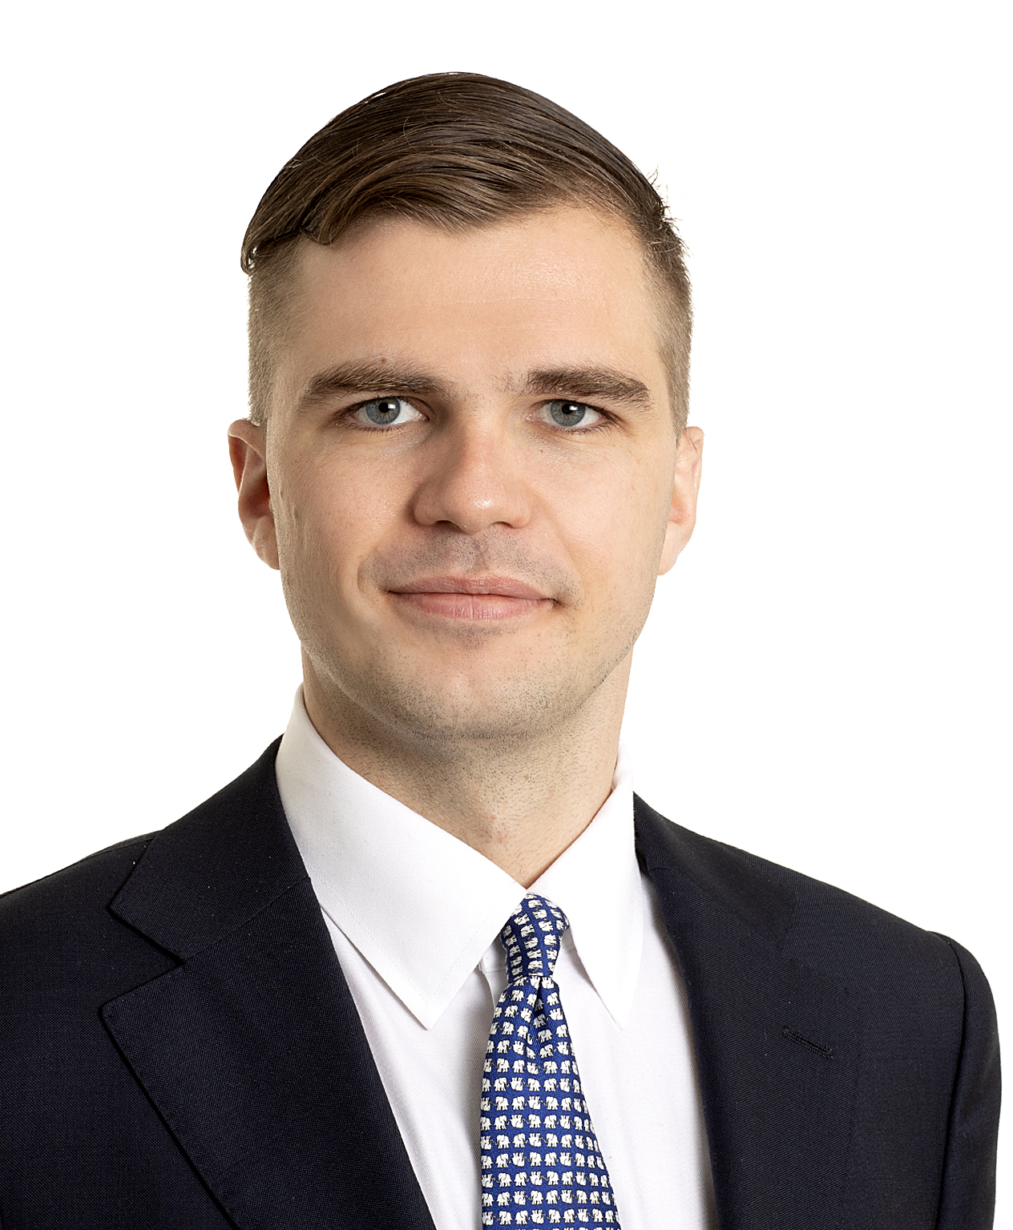
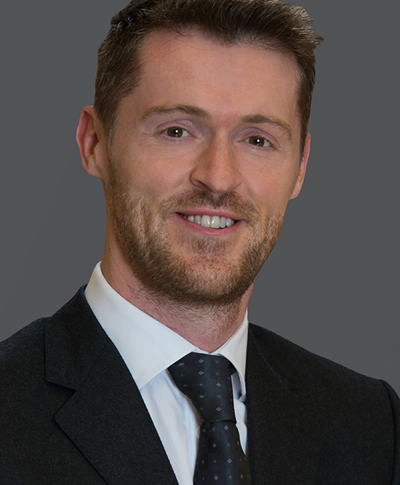
Presenters
Solveig Dalseg
Head of Financial Lines, Nordic Broking Centre
solveig.dalseg@aon.no
+47 45 86 99 65
Aksel Wilhelm Jebsen
Project Manager/Attorney at Law MNA
Aon M&A and Transaction Solutions
aksel.wilhelm.jebsen@aon.no
+47 98 66 78 67
James Whitaker
Head of Financial Lines Coverage
Global Broking Centre and UK Commercial Risk
james.whitaker@aon.co.uk
+44 (0)7407 876 092

Slide 3
Agenda
1
2
3
4
D&O Insurance
Quick introduction and brush-up
Claims Developments
Trends and Examples
Market Update
Domestic and International
Pricing and Terms
Outlook
What are the issues to be aware of going forward

Slide 4
What does a Directors and Officers (D&O) insurance cover?
«The directors and officers legal liability for financial losses inflicted in their capacity as such»

Slide 5
Three core requirements
To bring action against a director under the tort of negligence, an injured part must show
that the director
owed a fiduciary duty
to the injured party;
there was a breach
of the fiduciary
duty; and
that the injured party
suffered damages
caused by the breach
IN THEIR CAPACITY AS SUCH
The insurance only covers claims incurred in the insureds’ managerial or directorial capacity
LEGAL LIABILITY
Basis for claim must be breach of duty. Basis can be found in both legislation and case law.
FINANCIAL LOSSES
The D&O insurance generally covers pure financial losses only

Slide 6

Directors’ and Officers’ liability is personal and unlimited

Slide 7
Who are typically covered under a D&O policy?
Officers / managers of the company
Directors of the Board
Employees who can incur management liability
Outside directors appointed by the company
The company
Employees, in their capacity as such
Grey = Covered
Red = Not covered

Slide 8
Coverage Elements of a typical D&O Policy
Side A
Pays on behalf of the insured person, non-indemnifiable claims - No retention
Side B
Covers the company’s indemnification obligation (balance sheet protection) - Retention
Side C
Covers the Company as an Insured for Securities Claims - Retention
Notes:
D&O insurance explained | AGCS (allianz.com)

Slide 9
Core Coverage Elements
Covered
Not covered
Wilfully inflicted losses
Unlawful enrichments and conduct
Uninsurable fines and penalties
The financial losses inflicted by the insured
The insured’s defence costs (legal fees, advisory fees)
Certain specified costs

Slide 10
Typical claimants
Insured
Creditors
Government & Regulatory authorities
Clients
The Company itself
Competitors
Shareholders and investors
Employees
Suppliers
Activists

Slide 11
The sum insured should be based on an assessment of the types of claims the directors and management would typically see in the relevant industry, adjusted for size and risk profile of company.

Slide 12
Limits of liability and how to pick?
D&O Limits of Liability
External issues
Industry Susceptibility to Claims
Analyst & Investor Expectations
Jurisdicational Consideration
Peer Groups
Developing case law
Regulatory Environment
Insurance market cycles
Internal Issues
Merger and Acquisition Activity
Risk retention policy
Composition of the board
Geographic location
Financial condition
Size/Market capitalisation
Ownership structure

Slide 13
Claims trends – a global perspective (1)
Overview – where are claims coming from?
    The company (breach of general duty claims)
    From shareholders (either on behalf of the company or in their
    own right)
          Derivative actions
          Unfair prejudice actions and other minority interest actions
          Securities claims
    Insolvency practitioners and creditors
    Customers and suppliers
    Employees and contractors
    Regulatory and prosecutorial bodies
    Emerging types of claim
    ESG and sustainability-focused
      Climate litigation
      “Greenwashing” and “Greenhushing”
      DE&I
      Governance failures
    Financial performance and statements
      Impact of Russia/Ukraine war
      Supply chains and general market volatility
      Emerging solvency concerns
    Consumer-focused
      Cartel activity / anti-competitive practices
    Data protection, privacy and AI

Slide 14
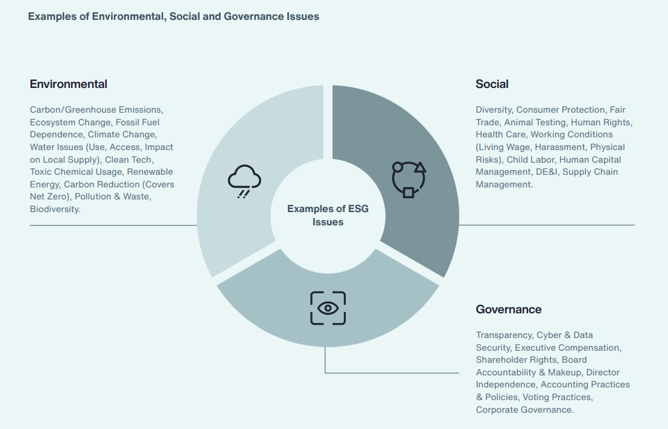
Claims trends – Environmental, Social and Governance (ESG) (1)
An umbrella term for a huge number of issues
A way of considering a business’ performance with a broader lens than only looking at profit margins
Tricky to measure – ‘raters’ exist but there is a lack of defined benchmarks
Increasing regulatory focus to increase transparency

Slide 15
Claims trends – Environmental, Social and Governance (ESG) (2)
    Why would a shareholder make a claim?
        Shareholding has lost value due to ESG initiatives
        Activist investors want to influence behaviour of company/Board
    WIDE range of ESG issues, some controversial:
        Boycotts / divestments (Ben & Jerries/Unilever)
        Diversity, Equity and Inclusion (Starbucks, Wells Fargo, Pfizer)
        #Metoo and other social justice issues
        Green-washing (multiple) and green-hushing
        Climate action
    WHY is this relevant to directors?
        D&Os who believe they are making socially/environmentally responsible decisions may face criticism from shareholders
        Directors are joined to shareholder proceedings on the basis of decisions they have made and alleged breaches of duty
        Claimants trying to access the D&O policy?

Slide 16
Claims trends – Shareholder litigation
    Anti-ESG claimant alleging mismanagement
    NCPPR v Board of Starbucks (WA, USA)
    Starbucks issued new DEI policies:
      setting hiring goals for ethnic minorities;
      awarding contracts to diverse suppliers;
      linking executive pay to diversity.
    Claimant (shareholder) alleges that the DEI policies:
      were discriminatory;
      breached state & federal civil rights laws;
      exposed Starbucks to corporate liability
(increasingly with an “ESG flavour”)
    Activist claimant alleging ESG failure
    ClientEarth v Board of Shell (UK)
    May 2021: a Dutch court held that Shell must act to comply with the Paris Treaty emissions targets e.g. NetZero by 2050 (Shell is appealing that ruling).
    ClientEarth’s derivative claim alleged:
      Shell’s strategy is not ‘Paris-aligned’;
      Shell overinvested in fossil fuels;
      therefore increasing the risk of stranded assets and disinvestment;
      D&Os are in breach of their duties (s.172)
    Breaches of duties to company
    Dieselgate D&O liability claims
    D&O liability claims – brought by the company against former executives (NOTE settlement approved by majority of shareholders but subsequently challenged by other shareholders)

Slide 17
Claims trends – Regulatory activity (1)
(also often with an “ESG flavour”)
    MANDATORY ESG reporting requirements now in force with the EU (and the UK)!
    Why would a regulator pursue directors and officers?
    Regulators (financial AND non-financial) are actively seeking to ensure that there is substance behind ESG claims:
        Investments or products marketed as “green”, “climate-friendly”, “socially responsible” etc.
        Public statements regarding the company’s green credentials or climate-related targets
    Companies need to be able to back up these claims when they are scrutinised
    For D&Os that could mean responsibility for:
        Putting adequate policies and procedures in place to ensure that ESG-products are researched and monitored
        Monitoring supply-chains to ensure that products continue to meet their green credentials
        Complying with increasing requirements to identify climate-related risks and opportunities
        Making accurate climate-related disclosures to regulators

Slide 18
Claims trends – Regulatory activity (2)
Early examples of enforcement action in the US, but increasingly in other jurisdictions
BNY Mellon (financial institution)
Investment advisor (BNYMIA) told investors that its affiliate would conduct ESG quality reviews as part of investment research for funds
SEC alleged that not all investments made on behalf of the funds had undergone ESG reviews and BNYMIA did not tell clients that its affiliate was not required to conduct ESG reviews on all investments
SEC cease-and-desist order re misleading statements in prospectuses
Settlement (no admission/denial): BNYMIA agreed to a cease-and-desist order, a censure, USD 1.5 million penalty
Vale (mining company)
Following a mining disaster in November 2015, Vale made public statements committing to safety and sustainability
January 2019, another Vale dam collapsed, killing 270 and destroying local environment
SEC enforcement action in NY alleged Vale intentionally concealed the dam’s instability from investors and Brazilian authorities i.e. misleading sustainability reports, periodic filings, and other ESG disclosures
Settlement: civil penalty of USD 25 million and disgorgement and pre-judgment interest of USD 30.9 million
NB: Vale has ADRs traded on a US exchange but is domiciled & operated outside the US

Slide 19
Claims trends – Corporate insolvencies and financial difficulties
    KEY POINTS
      Insolvency litigation has increased markedly over recent years
      The Company is not there to indemnify the director
    Directors’ duties when company is in financial distress – may shift, e.g. English law:
      SHIFT from duty to promote the company’s success (i.e. to act in the interests of the members as a whole) to a duty to act in the interests of the company’s creditors
      Sequana litigation
    WHO?
      Insolvency practitioners
      Creditors
      Shareholders
      Regulatory investigations, enforcement and director disqualification
    WHY?
      Withdrawal of government support
      Macro-economic headwinds
      Increasingly aggressive, and well-funded, creditors
      Increasing focus on directors’ conduct once the “dust has settled”
    The banking sector – some high profile examples
      SVB and Signature Bank
      Credit Suisse

Slide 20
D&O insurance and ESG exposures
      Most claims or enforcement actions have potential to impact a D&O policy.
      Definition of Claim – will it capture claims based on disclosures around ESG strategies, policies and procedures? What about letters of enquiry from pressure groups?
      Pre-Claim Inquiries – costs associated with internal investigations to determine if there has been a violation or a case to answer?
      Specific exclusions may be relevant e.g. Environmental Violation, Pollution, Employment Practices, Bodily Injury and Property; Fraud
      Importance of ensuring sufficient definition of ‘Insured Persons’ (may need expanding to include new roles)
      The insurance market is responding to the rise of ESG.

Slide 21
D&O Claims Development in Norway
Although the exact numbers are unknown, there has been a significant increase in the number of claims in the past five years

Slide 22
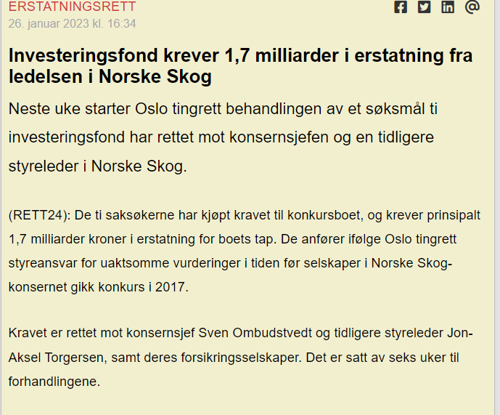
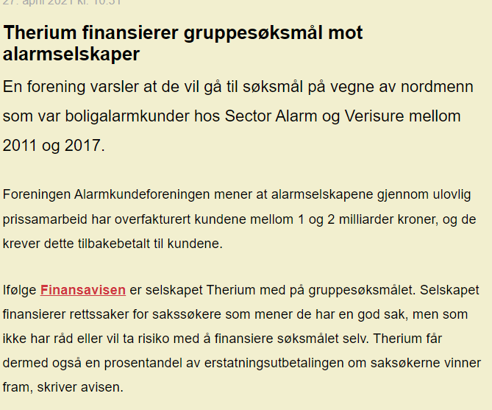
Two recent examples
(from Rett 24)

Slide 23
Norske Skog Claim
(A high level summary)
Claimants were a group of professional investors (hedgefunds) who had invested in securities (bonds) issued by Norske Skog and purchased claims from the bankruptcy estate of Norske Skog.
Defendants were a former chairman and CEO of Norske Skog as well as eight insurers participating on the Norske Skog program.
The claimants alleged that it was culpable of the defendants not to declare bankruptcy in H1 2016, but instead pay off outstanding debts and refinance. Norske Skog eventually declared bankruptcy in 2017, leaving the claimants with a loss on their investment.
The claimaints position was that if bankruptcy had been declared in H1 2016, their losses would not have occured.
Key question for the court: Was Norske Skog insolvent in H1 2016?
Answer: No. As there was no insolvency ther could not be any liability.

Slide 24

Key Takeaways from the Norske Skog Claim/Recent Case Law
The threshold for professional investors to make a claim is higher than for non-professional claimants.
Investors generally have to bear the risk of their own assumptions and expectations
The management and board generally have a broad discretion to exercise their judgement, as long as the basis for their exercise is sound/justifiable.
«(…) Det er en høy terskel for å ilegge styremedlemmer ansvar for forretningsmessige feilvurderinger. Selv om det er tatt en for stor risiko, eller dersom en prognose om forventet utvikling ikke slår til, må det altså spesielle grunner til for at det skal være aktuelt med erstatningsansvar.»
The costs of a claim can be considerable even when aquitted:
1. Cost of claimants: MNOK 19
2. Cost of defendants: MNOK 74 (MNOK 20 reduction by the courts)
Total cost one round in court: MNOK 93

Slide 25
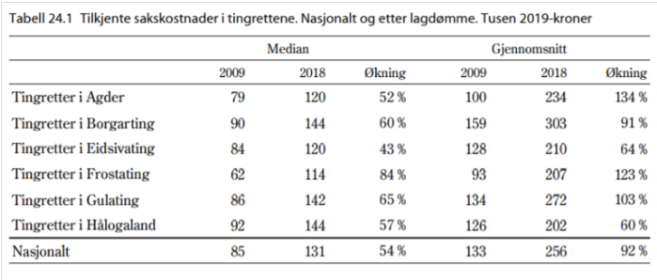
The lawyers always win…

Slide 26
Alternative financing of claims
Pro-Bono
Legal representative agrees to waive fees in the event of a loss, but receives payment if successfull (hours calculated)
Claimant needs to pay opponent’s costs in the event of a loss
Transfer of Claims
Creditors may generally transfer their claims freely without the debtors consent under Norwegian Law.
The new creditor may pursue the claim in their own name and at their own risk, with the right to (full) recovery if successfull
Litigation Funding
A third party agrees to fund the litigation costs of the claimant for a fee.
Claimant pursues the claim in their own name and at their own risk.
Funder pays/receives remuneration from the claimant but has no claim towards defendant.
Public Interest Group
A public interest group such as The Consumer Protection Counsil may agree to conduct the case on behalf of the claimant, taking all economic risk associated.

Slide 27

Spotlight: Litigation Funding and Class Action Lawsuits
Both litigation funding and class action lawsuits are quite new concepts in Norway
Traditionally: «Pilot cases» with or without a public interest supporter
Class action: Comparable/Equal claims (1) subject too same legal basis (2) joint treatment preferrable (3) group representative (4)
Two types: opt-in and opt-out
The group representative is responsible for payment of own and counterparty’s legal fees.
Can the group representative deduct the cost of funding the litigation from the amount awarded to group members in an opt-out class action?
HR-2023-01034: No, the group representative cannot make such deductions.

Slide 28

Key Takeways from Recent Developments
Although personal and unlimited, the threshold for liability is generally material where due care has been exercised.
Liability does normally not attach to erroneous business judgement, if judgement was exercised in good faith.
Increased focus on directors and officers liability has however increased number of claims.
Legal costs have increased significantly over the past decade
Not having a D&O insurance exposes a director or officer to substantial financial scrutiny even if aquitted

Slide 29
D&O Liability – London Market update (1)
THE CONTEXT:
Continued – and growing – economic uncertainty (and related corporate pressures), litigation and regulatory exposures.
Certain industries, and jurisdictions, particularly challenged:
    Banking and finance; extractive industries; sports, media and entertainment; life sciences
  US exposures, including non-US parent companies
        (NB possible expansion of Caremark duty as a signal of direction of travel (McDonalds Corporation Stockholder Derivative Litigation))
  Parent company exposures in respect of operations and activities of overseas subsidiaries
NONETHELESS – Some signs of market stabilisation?

Slide 30
D&O Liability – London Market update (2)
 | New entrants to the London market are providing welcome relief on rates (flattening and reducing premiums): Rising Edge, Inigo, Convex, SCOR, Tegron and IQUW are mostly interested in primary/low excess positions on programs, increasing competition on these layers. Key markets for primary and low excess still favour those with trusted claims experience: AIG, AWAC, Beazley, Berkshire Hathaway, Zurich, Chubb and WRB. Insurers are still managing capacity and premium rates in high-risk industries (eg. Biotech, Healthcare, Hospitality, Aviation, Retail and Oil and Gas). Severely limited appetite and capacity for standalone ancillary lines, with most insurers only considering the Crime, Fiduciary and EPL where they also write the D&O.
 | Retentions are generally remaining stable if Insureds saw an increase at their 2020/21 renewal, although performance during the pandemic is being taken into consideration.
 | Competition from new carriers and high budget targets from existing insurers means primary/low excess rates are flattening or potentially decreasing depending on prior premium increases and company performance “post” pandemic. Downward pressure currently exists on most renewals Excess layers with higher ILFs are being challenged with alternative capacity keen to quote Inverted layers no longer the norm
Capacity
Retentions
Pricing

Slide 31
D&O Liability – London Market update (2)
 | New entrants to the London market are providing welcome relief on rates (flattening and reducing premiums): Rising Edge, Inigo, Convex, SCOR, Tegron and IQUW are mostly interested in primary/low excess positions on programs, increasing competition on these layers. Key markets for primary and low excess still favour those with trusted claims experience: AIG, AWAC, Beazley, Berkshire Hathaway, Zurich, Chubb and WRB. Insurers are still managing capacity and premium rates in high-risk industries (eg. Biotech, Healthcare, Hospitality, Aviation, Retail and Oil and Gas). Severely limited appetite and capacity for standalone ancillary lines, with most insurers only considering the Crime, Fiduciary and EPL where they also write the D&O.
 | Retentions are generally remaining stable if Insureds saw an increase at their 2020/21 renewal, although performance during the pandemic is being taken into consideration.
 | Competition from new carriers and high budget targets from existing insurers means primary/low excess rates are flattening or potentially decreasing depending on prior premium increases and company performance “post” pandemic. Downward pressure currently exists on most renewals Excess layers with higher ILFs are being challenged with alternative capacity keen to quote Inverted layers no longer the norm
Capacity
Retentions
Pricing

Slide 32
D&O Liability – Nordic Market Update
 | New and ‘revived’ capacity entering the market Key markets for primary still limited - AIG, Zurich, Chubb (AXA XL) Still two-tiered market where “good” risks get more favorable terms EUR 10m per risk, sometimes up to EUR 15 and even more on ventilated excesses
 | Increased retention levels US Entity Securities Claims Company reimbursement retention outside US increasingly common
 | Mostly flat renewals also on excess, but de facto premium reductions not uncommon (increased risk, increased sum insured at expiring premium) Inverted layers and bipar pricing fully possible to avoid
Capacity
Retentions
Pricing

Slide 33

A look into the future – the D&O issues of tomorrow

Slide 34

Cyber
Increased focus on cyber and cybersecurity as a management and board responsibility
Example from Germany: CEO found personally liable for GDPR Breach
Massive increase in cyberattacks and cyber incidents over the past 5 years (e.g. number of ransomware attacks increased 300% from 2019 to 2022)
Average cost of Data Breach in the Nordics: MNOK 20
New NIS 2 regulation and new law on digital security (digitalsikkerhetsloven)
Social inflation and more litigous environment

Slide 35

ESG
Heightened focus on ESG and CSR over the past few years
New legal duties of companies
Transparancy Act
Duty to disclose wether a D&O insurance has been taken out
Public companies: Duty to make an annual statement on social responsibility

Slide 36
Other potential exposures
General heightened geopolitical risks
Continued macro-economic pressures
Technology (including in relation to Artificial Intelligence) and data protection
Class and collective proceedings and mass tort litigation
Special Purpose Acquisition Companies (SPAC) litigation
  – a new phase?
Continued banking industry exposures

Slide 37
FINAL REFLECTIONS
With new times comes new responsibilities
Breach of duty ≠ Liability (actual loss and causation also has to be established).
A D&O insurance provides a valuable hedge against claims and defence costs in an increasingly litigious environment.
Aon expects an increase in claims in the coming years.

